Slide 1
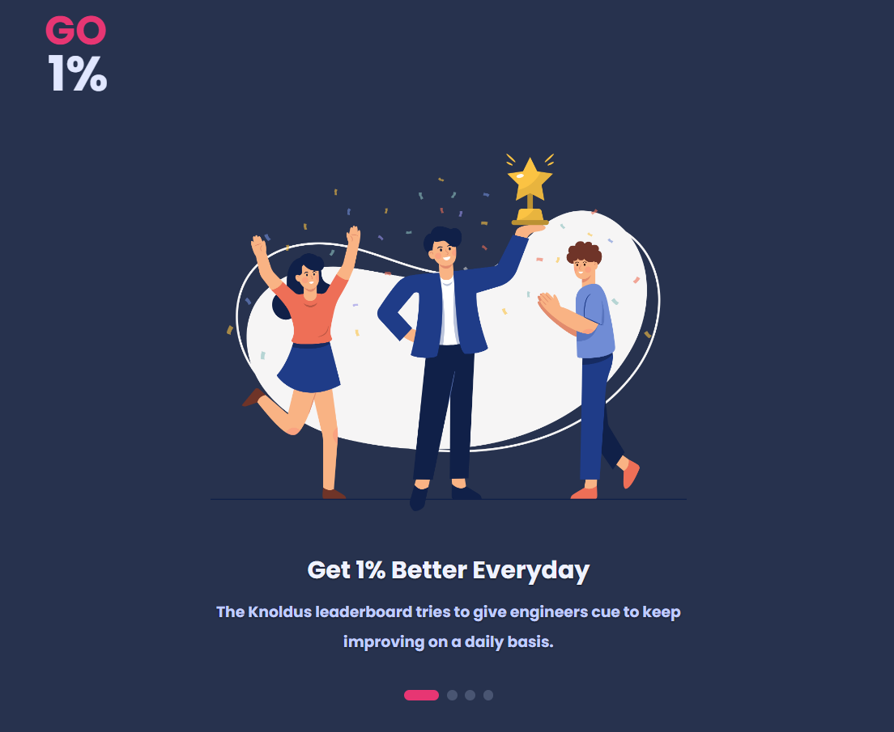
title : - “ Go 1 %”

Slide 2

Project Supervisor
Dr. Sangeeta Arora
Team Members
Mohika Rastogi – 2100290140086
Ayush Pathak– 2100290140046

Slide 3
INTRODUCTION
The Go 1% is a website which is an innovative leaderboard solution designed to enhance individual learning and incentivize employees to go beyond their limits.
Most times when we are in doing our day to day jobs and become familiar with the technology that we are working with, we get lazy and bored, we stop feeling good about our job and we stop learning.
Go 1% is a powerful tool that promotes a culture of continuous learning and improvement within an organization. The leaderboard is an interactive interface that enables employees to track their progress, compete with their peers, and earn recognition for their achievements. The platform will be designed to provide comprehensive analytics and performance reports that help managers monitor employee progress in real-time. With modules such as Radar, Techhub, Knolx, and Helpdesk, the platform provides employees with learning resources, knowledge sharing, and technical support.
It will maintain records of knolx sessions given by the employees and there scores.
It will manage the data and schedules of the upcoming sessions and which dates will be available for others to book the session and which are booked.
The Go 1% Leaderboard can be a great tool for organizations that want to improve their employees' skills and productivity, and create a positive and engaging workplace culture.

Slide 4
TECHNOLOGIES USED
FRONT END
Angular
BACK END
Scala
MongoDB
Akka

Slide 5
MINIMUM HARDWARE REQUIREMENT
Processor 11th Gen Intel(R) Core(TM) i3
System Type 64-bit operating system
Speed 3.00 GHz
Hard Disk Space 256 GB
Ram Memory 8 GB
Operating System Window 11

Slide 6
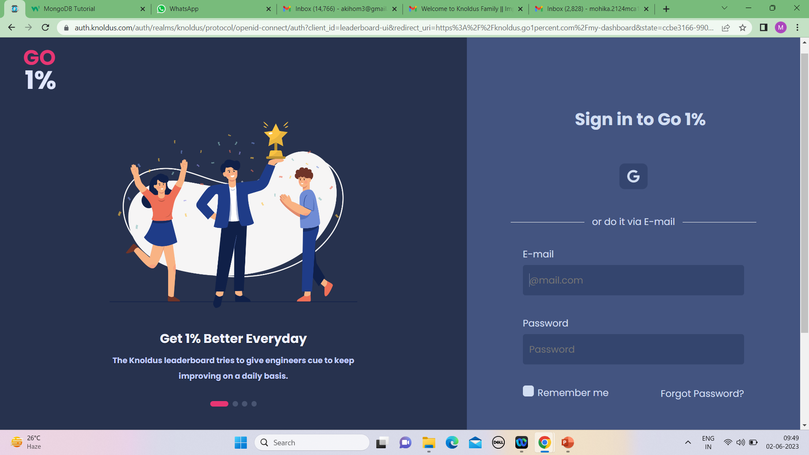
MODULES DESCRIPTION
Welcome Display
This is a first page of website that displays the welcome screen for the User & Admin.

Slide 7
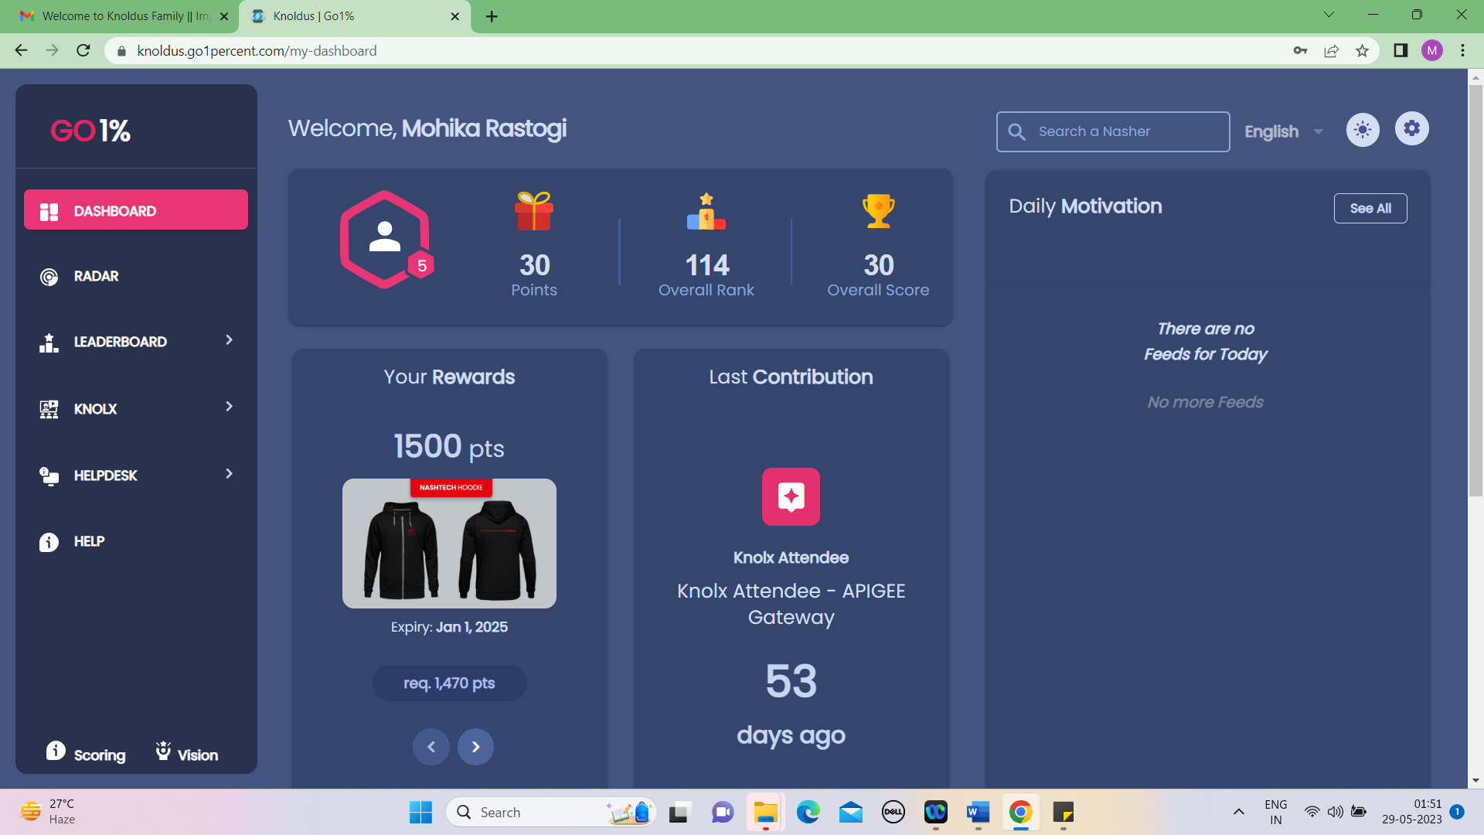
Dashboard Module
This Page is a menu-based that displays the menu for register Fir details.

Slide 8
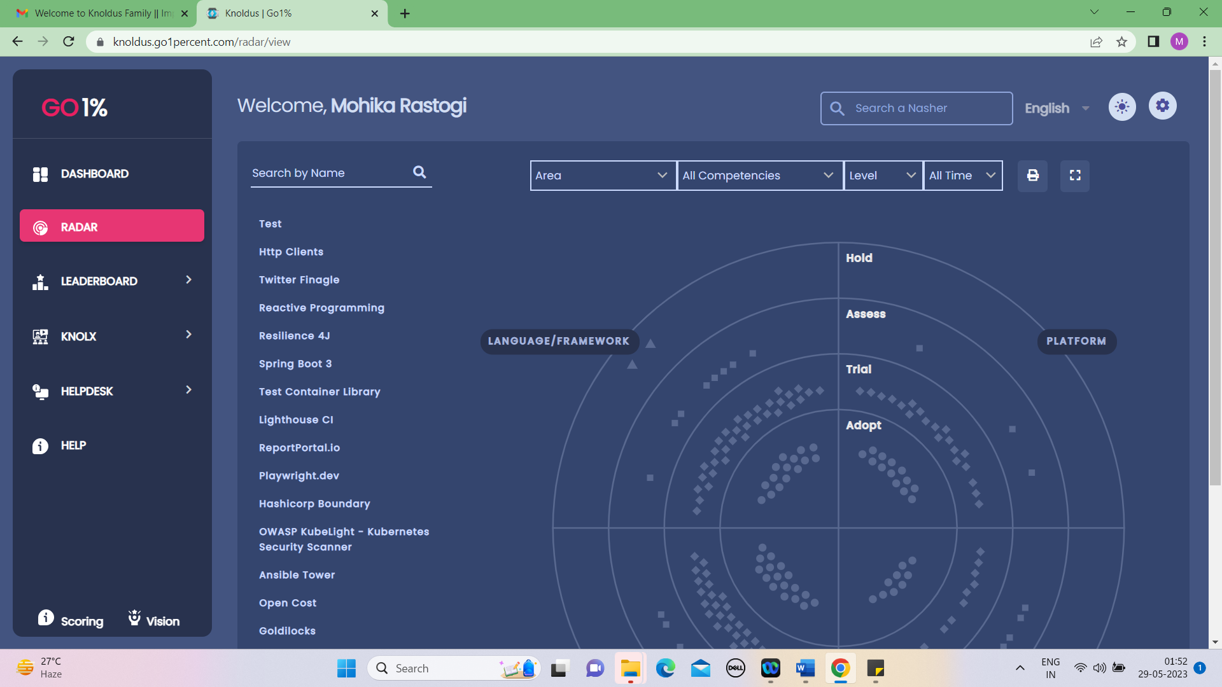
Radar Module
This Page is a menu-based that displays the menu for operation of the website. It includes various options like edit profile, update profile, manage account related option.

Slide 9
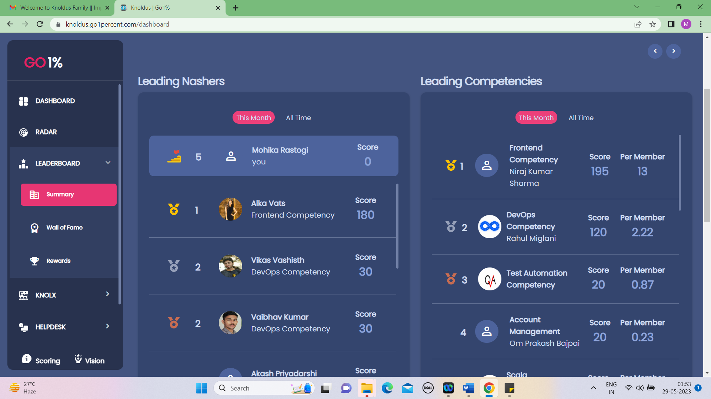
Leaderboard Module
.

Slide 10
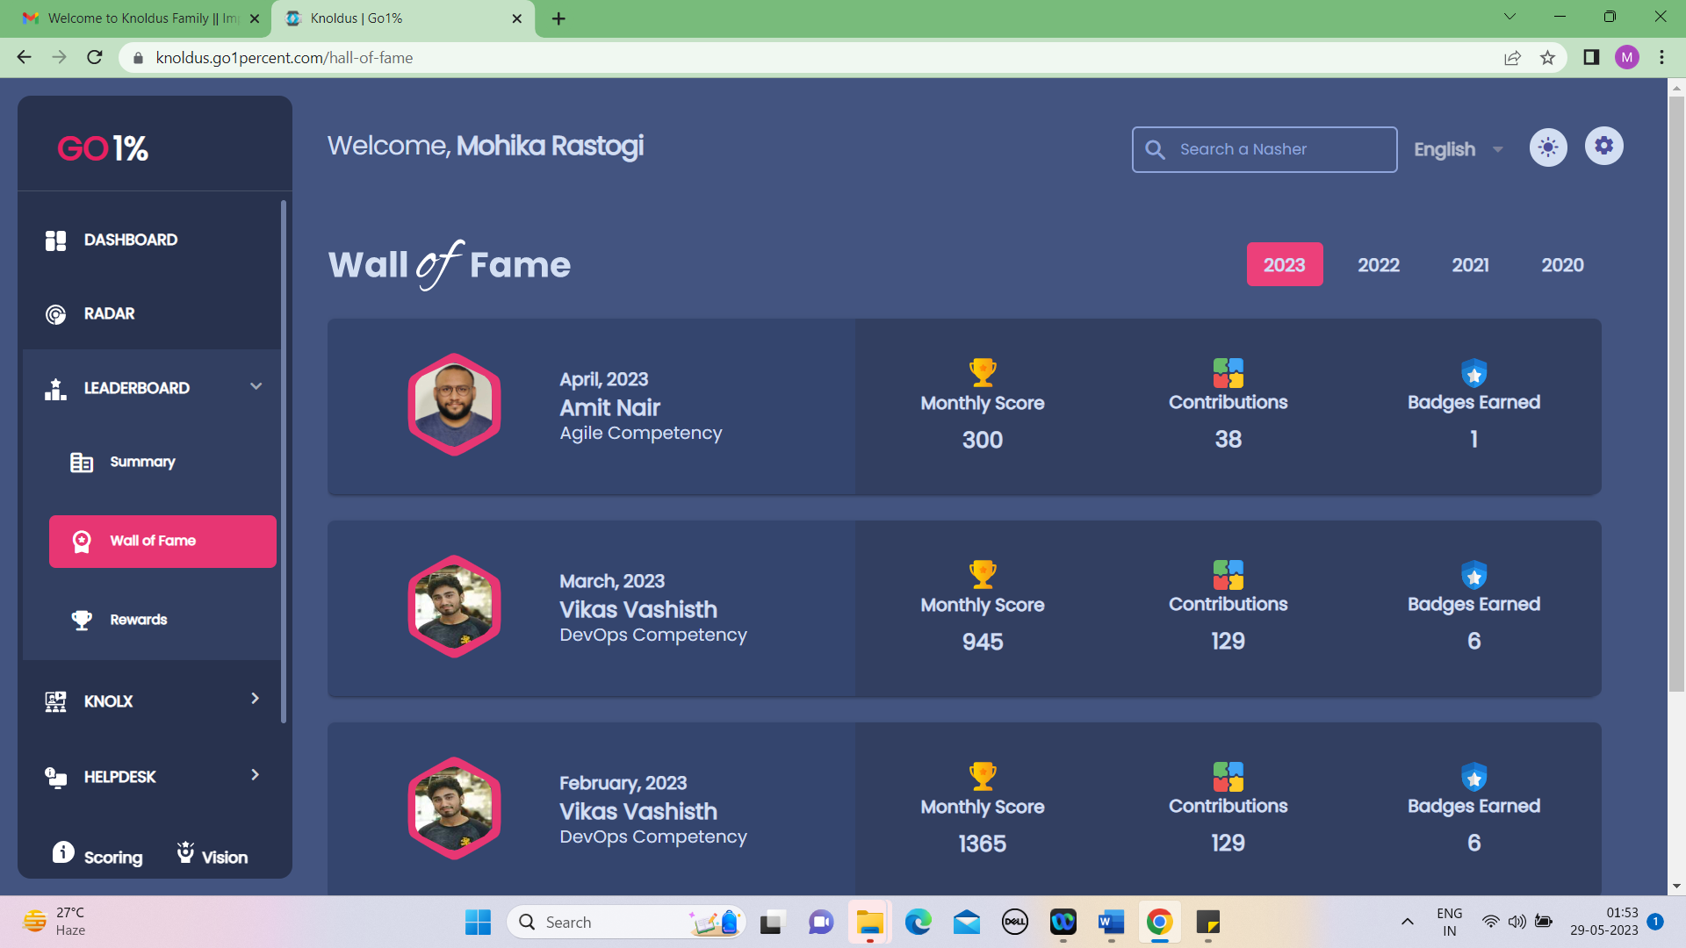
Wall Of Fame
User can contact us & give feedback according to their analyse.

Slide 11
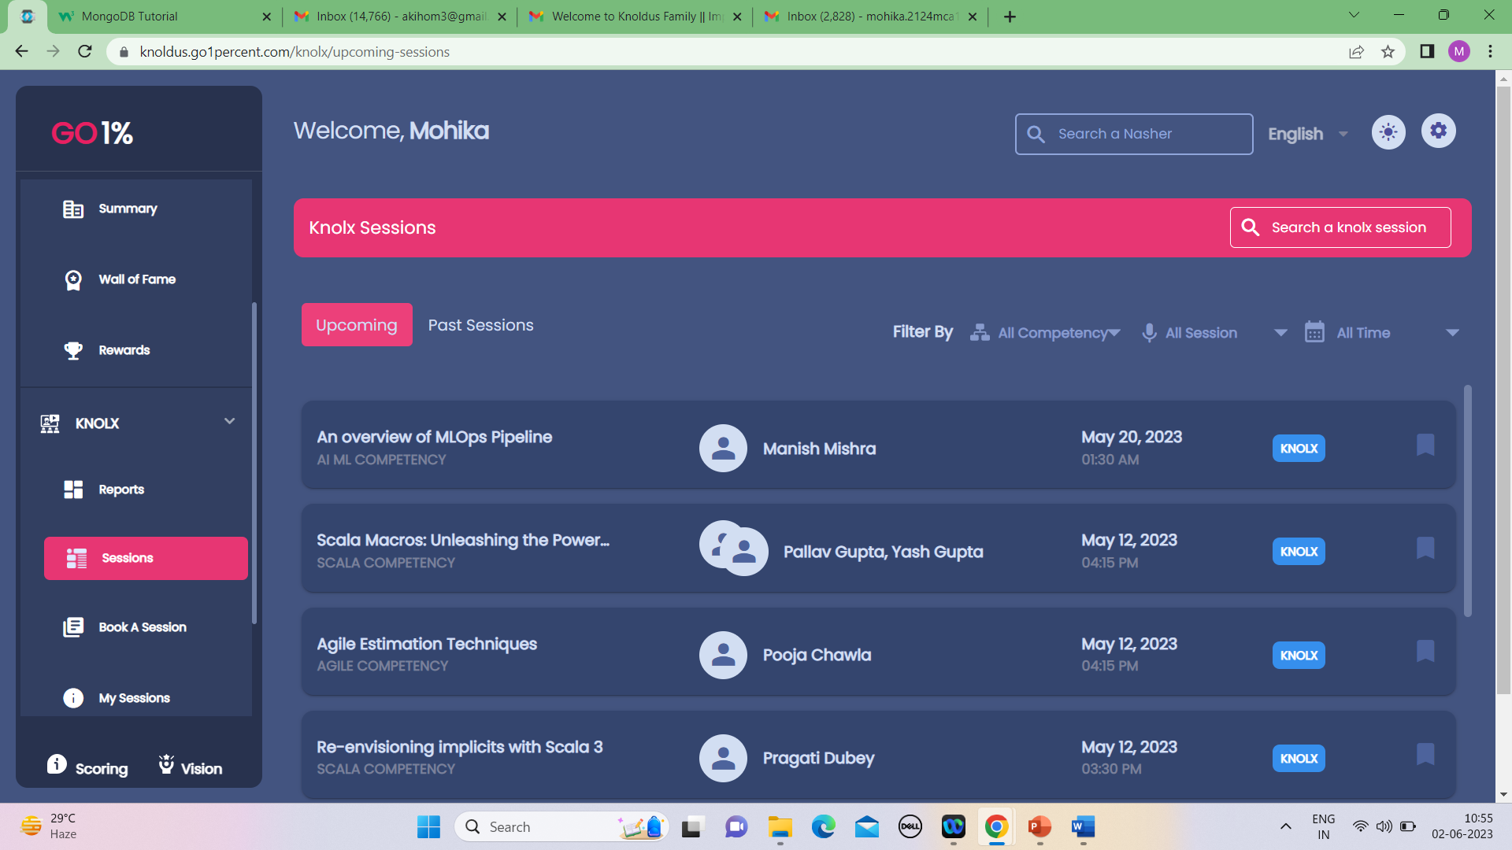
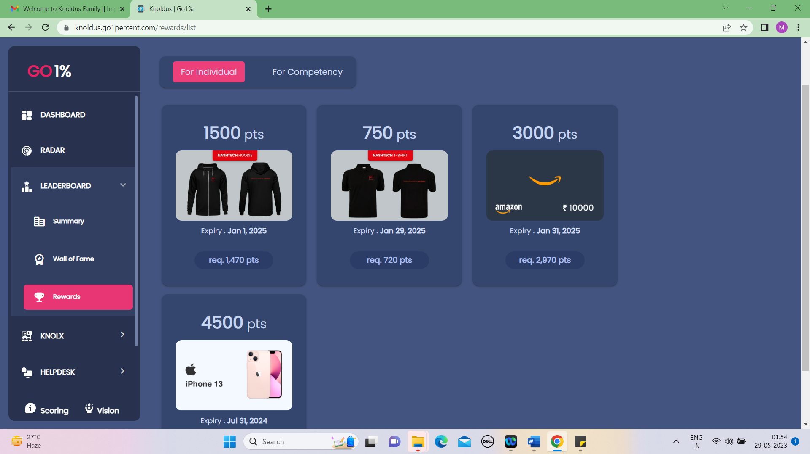
Knolx Sessions analyse.

Slide 12
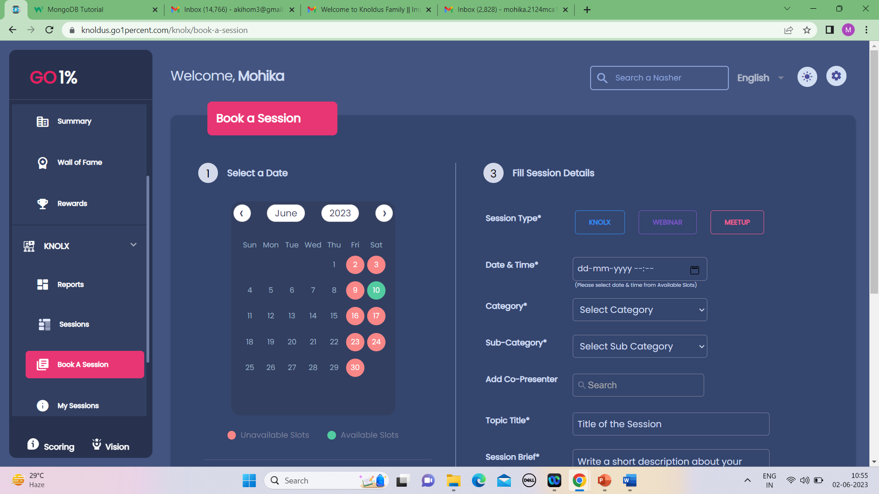
Book A Session

Slide 13
REPORTS / OUTPUTS
The Go 1% leaderboard platform offers a comprehensive and engaging solution for organizations to promote learning, development, and healthy competition among employees. With its various modules, including the Dashboard, Radar, Leaderboard, Techhub, Knolx, Helpdesk, and Help, the platform provides employees with a user-friendly interface and a wealth of features to enhance their personal and professional growth. Overall, the Go 1% leaderboard platform provides a comprehensive solution that not only enhances individual growth but also promotes a culture of learning and healthy competition within organizations. By leveraging its various modules, employees can actively engage in their personal and professional development, leading to increased productivity, innovation, and success for both individuals and the organization as a whole.

Slide 14
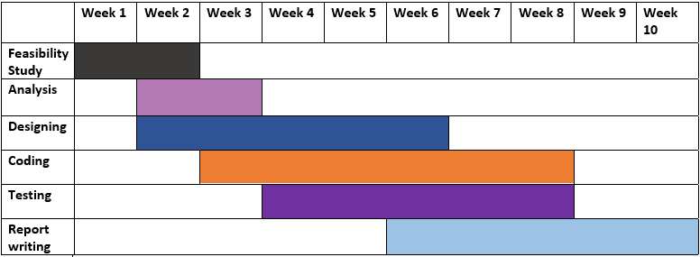

Slide 15


